Slide 1
DS-306 Data Warehousing and Business Intelligence
Topic 4: Types of DW Schemas, Data Marts
Dr. Khurram Shahzad

Slide 2
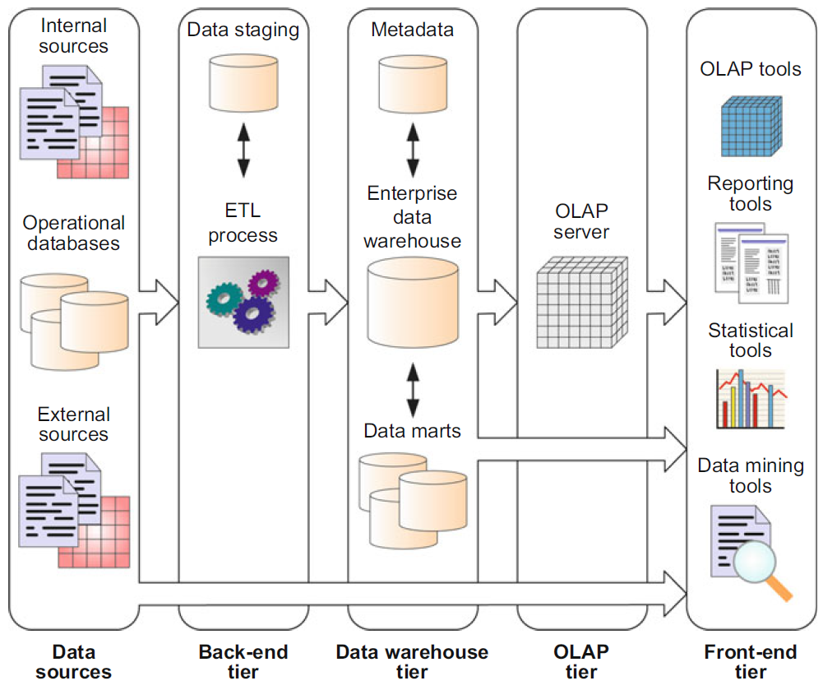
Typical DW architecture

Slide 3
Star Schema
Dimension tables are not normalized
Therefore, they may contain redundant data
Especially, in the presence of hierarchies

Slide 4
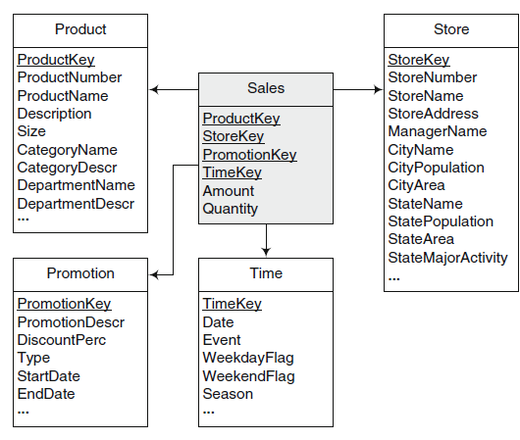
Example Star Schema

Slide 5
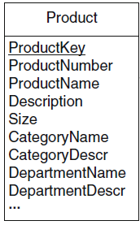
Start Schema
Example: Product Dimension
  All products belonging to the same category
  So, all the category information will be redundant

Slide 6
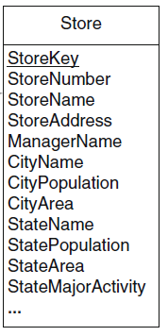
Start Schema
Example: Store Dimension
  All stores (unique) belong to a city
    So, all the category information will be redundant
  All stores (unique) belongs to the same state
    So, all the state information will be redundant

Slide 7
Star Schema Keys
Primary keys (in dimension)
  Identifying attribute in dimension table
  Relationship attributes combine together to form P.K
Surrogate keys (in dimension)
  Replacement of primary key
  System generated
Foreign keys (in fact, dimension)
  Collection of primary keys of dimension tables
Primary key to fact table
  Collection of P.Ks

Slide 8
Types of Dimensions
Based on size (columns and data)
  Large dimensions
  Small dimensions
Based on changes to data
  Slowly Changing Dimensions
  Rapidly Changing Dimensions

Slide 9
Dimensions Types: Size
Based on size
  Large dimensions
  Small dimensions

Slide 10
Large Dimensions
A dimension is considered large based on two factors
  A large dimension is deep i.e., large no of rows
  A large dimension is wide i.e., large no of columns
For example, customer, product and time dimension may be gigantic
Multiple hierarchies
  Large dimensions tend to have multiple hierarchies

Slide 11
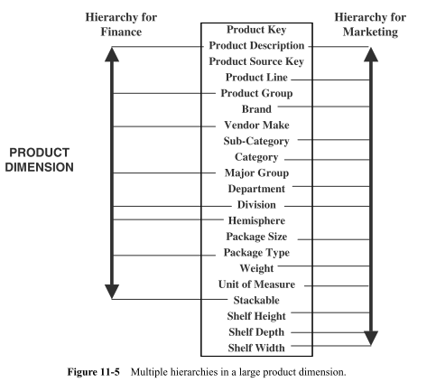
Example Large Dimension

Slide 12
Small Dimensions
Little deep
  Fewer rows
Little wide
  Fewer columns
Typically, single hierarchy
Examples
  Small Customer dimension
  Small Product dimension
  Small time dimension

Slide 13
Types of Dim: Data Changes
Based on changes to data of dimension
  Slowly Changing Dimensions
  Rapidly Changing Dimensions
Beforehand, lets discuss what are data changes

Slide 14
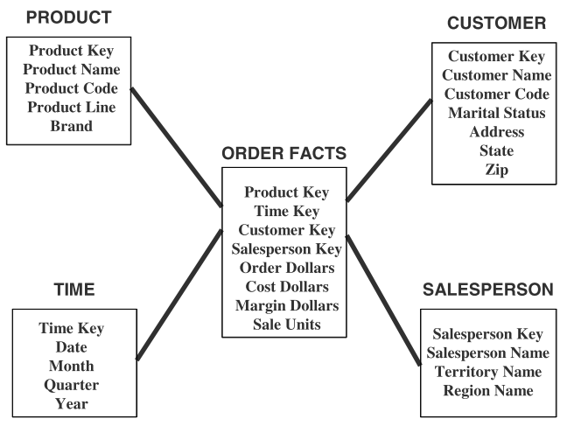
Updates to dimensions
Fact: sales units
Dimension: Product
  Change: A new product is added
Dimension: Customer
  New customer is added
  Customer is relocated
  Marital status is changed

Slide 15
Types of Changes
Type 1 Changes: Correction of errors
Type 2 Changes: History preservation
Type 3 Changes: Tentative revisions

Slide 16
Incremental load
DW is updated once
Next time update / incremental update

Slide 17
Type 1: Correction of Error
For example, spelling of customer name is changed from Hammad Ikram to Hammad Akram
  No need to preserve old value of Hammad “Akram”

Slide 18
Types 1: Correction of Error
Kristian Daniel to Kristian Denial and the martial status is changed from single to married
  No need to preserve old value of name
  But change in martial status is slightly different
Affect on result
  Number of perfume products bought by married persons

Slide 19
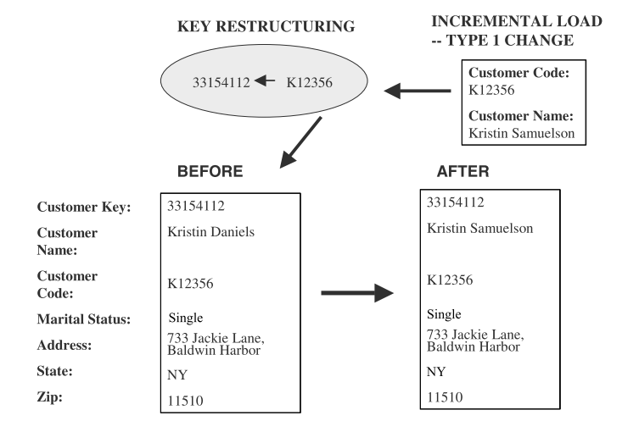
Types 1: Correction of Errors
Changes to DW
  Solution, over-write old values with new values
  Old value is not preserved
  Key is not affected
  Easiest to implement

Slide 20
Type 2 changes: Preservation of History
Assume that in DW an essential requirement is to track orders by marital status
  If change happed on 1 Jan 2024 all order before that should be included in martial status single.
  Similarly orders after that under marital status married
  Assume city is also changed from LHR to ISL so both changes must be saved
Principles:
  Relate to true change in source systems
  There is a need to preserve history in DW

Slide 21
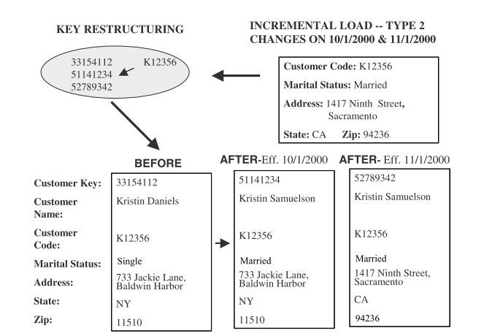
Type 2 changes: Preservation of History
Applying Type 2 changes in DW
  There are no change to the original row in dimension table
  Add a new dimension table row
  The key of the original row is not affected
  The new row is inserted with a new surrogate key

Slide 22
Type 3 changes: Tentative Soft Revisions
We apply Type 2 change to a certain date (the date is a cut off point)
  What if you need to count the orders on or after the cut-off date in both groups? This cannot be handled with type 2
  i.e. sometimes there is a need to track both old and new values for a certain period
  For instance, realigning territories

Slide 23
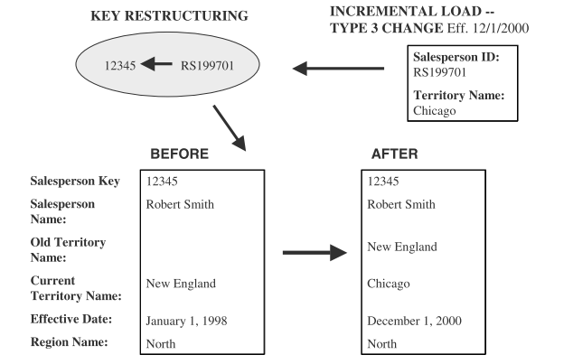
Type 3 changes: Tentative Soft Revisions
Solution
Add a new field in the dimension table
  Push down the existing values from current to old
  Keep the new values of the attribute in the “current” field

Slide 24
Summary of Types of changes
Change1. Correction of errors
  Problem, Name of a person is changed, to correct error
  Solution, over-write old value
  Old value is not saved
  Key is not affected, Easiest to implement
Change 2. History preservation
  Problem, Name is changed, marital status & address
  Solution, Inserting new row for each change
  Change has certain affect on analysis
  Key is not affected, new surrogate key
Change 3. Tentative revisions
  Problem, Old address of customer is not known
  Solution, Insert another attribute, with date
  New row is not needed

Slide 25
Recall Types of Dim: Data Changes
Based on changes to data of dimension
  Slowly Changing Dimensions
  Rapidly Changing Dimensions

Slide 26
Slowly Changing Dimension
Consideration of the changes to dimension table
  Many dimension, though not constant over time, change slowly
  Product key of source record does not change
  Description and other attributes change slowly over time
  In OLTP new values overwrite old ones
  Overwriting not always appropriate option in DW

Slide 27
Rapidly Changing Dimension
For Type 2 changes, a new row is created with new attribute value
  Preserve the history
What if the change occurs too many times?
This dimension is no longer a slowly changing dimension
Particularly, in Large dim. frequent changes cannot be handled with any type of change

Slide 28
Rapidly changing dimensions
But consider a large customer dimension, where millions of customers may exist
  But significant attributes in a customer dimension may change many times in a year (rapidly changing dimension)
In the case if dimension table is too large and changing too rapidly
Solution????

Slide 29
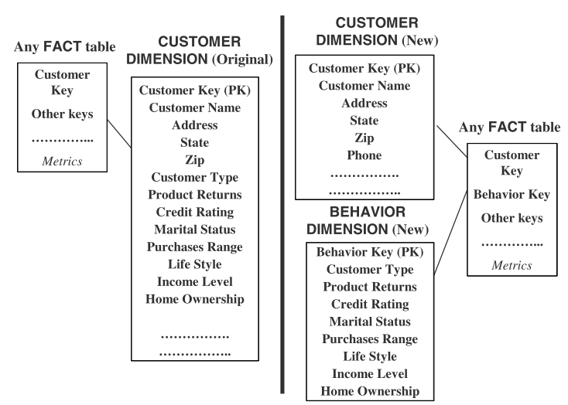
Rapidly changing dimensions
Leads to
Snowflake

Slide 30
Types of Dimensional Models
Star Schema (discussed)
Snowflake Schema
Starflake Schema
Constellation Schema

Slide 31
Snowflake Schema
Snowflake avoids the redundancy of star schemas by normalizing the dimension tables
Therefore, a dimension is represented by several tables related by referential integrity
Referential integrity constraints is also between fact table and the dimension tables at the fines level of details

Slide 32
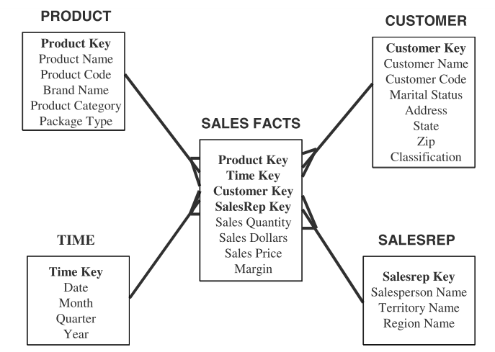
From Star to Snowflake Schema

Slide 33
Normalization of Dimensions
1st Normal Form
2nd Normal Form
3rd Normal Form

Slide 34
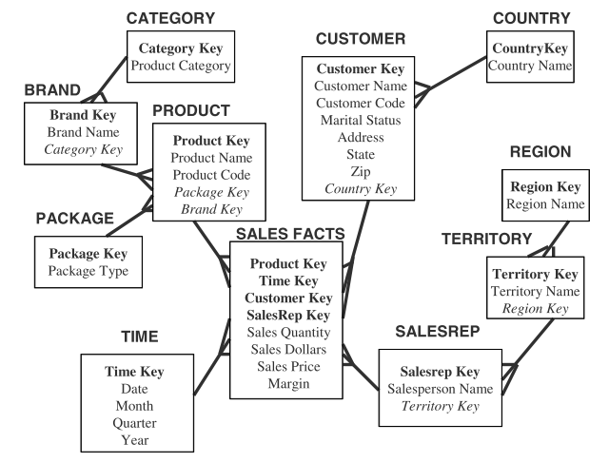
From Star to Snowflake Schema

Slide 35
From Star to Snowflake Schema

Slide 36
Search Reduction in Snowflake
Assume there are 500,000 product dimension rows
And 500 product brands, 10 product categories
Query about 1 product category
  Searching will be performed on 500,000 rows
  But, if it partially normalized by product brands and product category
  Initial search, 10 rows

Slide 37
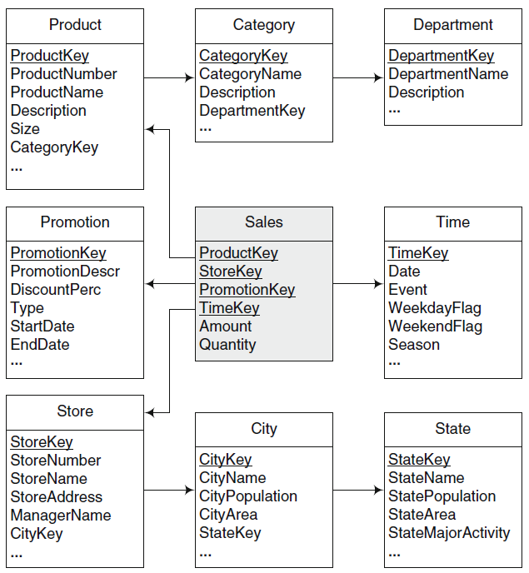
Another Example
Snowflake

Slide 38
Snowflake: Advantages & Disadvantages
Advantages
  Small saving in storage
  Normalized structures are easier to update
Disadvantages
  Schema is less intuitive (complex)
  Ability to browse through content difficult
  Degraded query performance due to joins

Slide 39
Starflake Schema
A combination of star and snowflake.
Some dimensions are normalized while others are not
Constellation Schema
Schema has multiple fact tables that share dimension tables

Slide 40
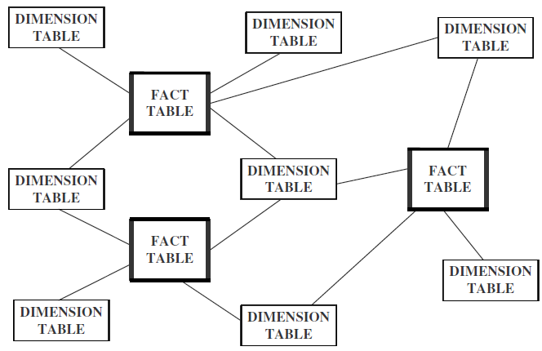
Constellation Schema

Slide 41
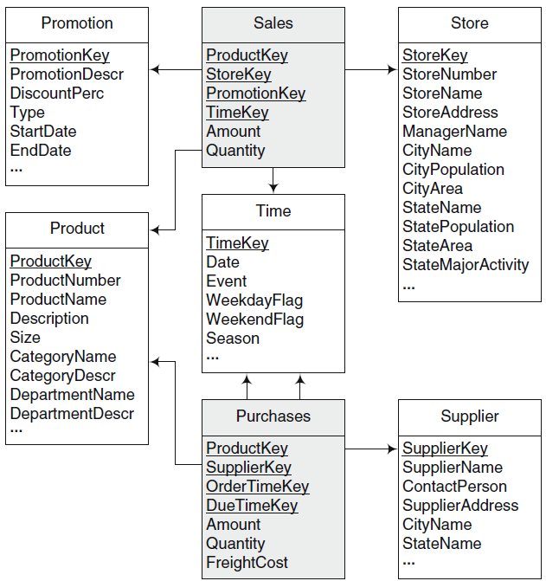
Constellation Schema Example

Slide 42
Typical DW architecture

Slide 43
Data Marts
DW aims at analyzing the data of entire organization
Sometimes, departments or division requires portion of the data warehouse
They have specialized needs
  Sales department needs sales data
  HR department need demographic data and employee data
Departmental data warehouses are called data marts

Slide 44
Data Marts
Marts can be derived from DW or from data sources
Can have Star or Snowflake schemas
DW can be seen as a collection of data marts
Marts are easier to build than an enterprise DW

Slide 45
Data Marts
Two types of design approach
  Bottom-up approach
    Marts → DW
  Top-down approach
    DW → Marts

Slide 46
Top-down Approach
Advantages
  A truly corporate effort, enterprise view of data
  Inherently architecture – not a union of marts
  Single, central storage
Disadvantages
  Takes longer to build
  High risk of failure
  Needs high level of cross-functional skills

Slide 47
Bottom-down Approach
Advantages
  Faster and easier implementation
  Favorable return on investment for PoC
  Inherently incremental
  Allows project team to learn and grow
Disadvantages
  Data mart has its own narrow view of data
  Redundant data in every mart
  Perpetuates inconsistent and irreconciled data

Slide 48
When to use DW or Mart?
Questions that determine DW or Data Marts
  Top-down or bottom-up approach
  Enterprise-wide or departmental
  Which first – data warehouse or data mart
  Build pilot or go with full-fledge implementation
  Dependent or independent data marts

Slide 49
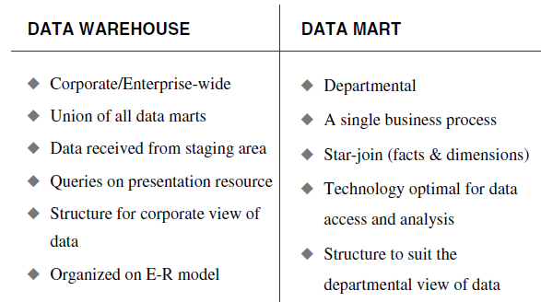
DW vs Marts Summary

Slide 50
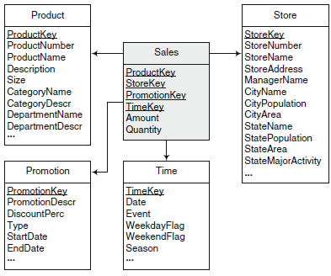
Case Study: Draw Snowflake

